Slide 1
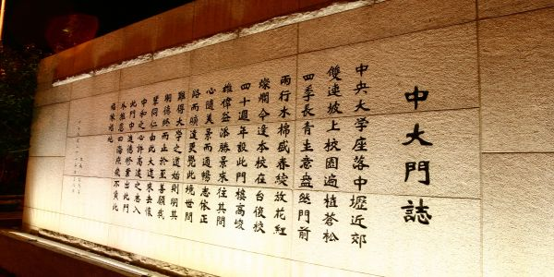
Practical Software debugging and testing
Yung-Pin Cheng (鄭永斌)
Associate Professor
Department of Computer Science and Information Engineering
National Central University

Slide 2
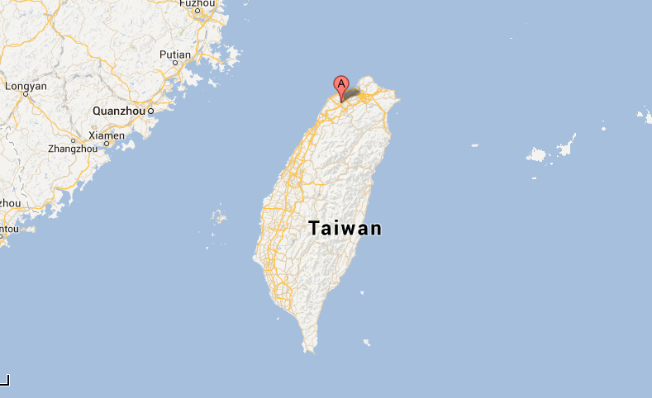
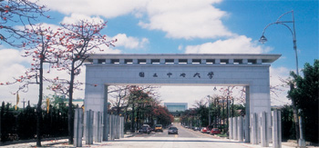
Where am I from?

Slide 3
Testing vs. Debugging
Two techniques are sometimes mixed and confused
Software testing is
use testing tools and testing methodology to find BUGs
done by QAs(Testers)
Many testing tools are used.
debugging is
when a BUG is found, find the root cause, fix the program, and make sure it can pass the tests.
by developers
use debugging tools.

Slide 4
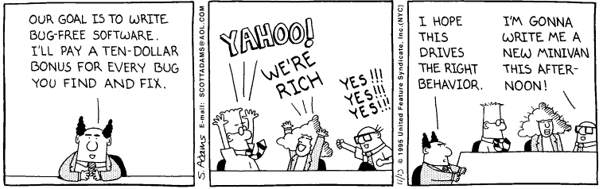
Bugs are everywhere

Slide 5
The QC story
product
error rate
software development
other manufacturing
discipline
QC process improvement

Slide 6
Software Quality
Unlike other engineering disciplines, software industry is one area that humans are the main task forces.
No humans (programmers) are perfect
This explains why software testing is important because you cannot fully trust humans.

Slide 7
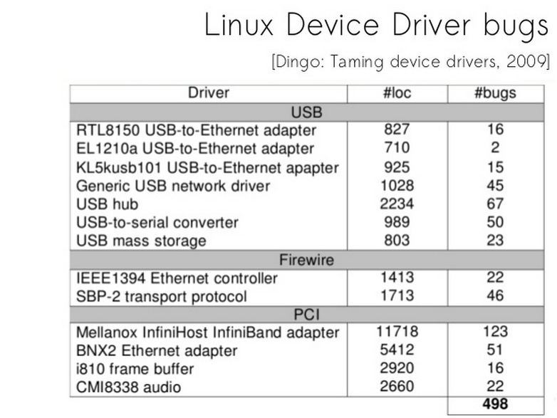
How programmers can create bugs easily

Slide 8
What is a BUG?
A software bug is the common term used to describe an error, flaw, mistake, failure, or fault in a computer program or system that produces an incorrect or unexpected result, or causes it to behave in unintended ways.

Slide 9
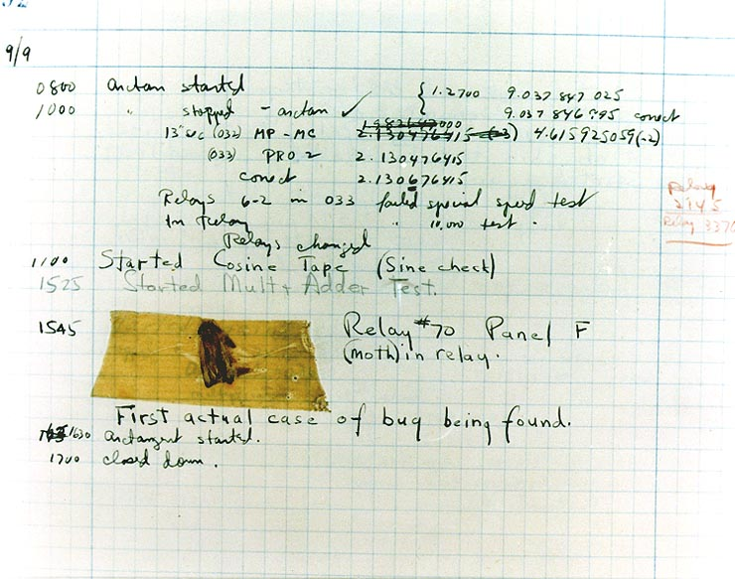
1946 Grace MurrayHopper ( who invented COBOL)
find a moth in Mark III National Museum of American History

Slide 10
How Bugs are produced?
programming errors (e.g.: typos)
Design and logic errors
Compiler errors (rarely )
Memory management faults
Specs errors
Third party component (library)errors

Slide 11




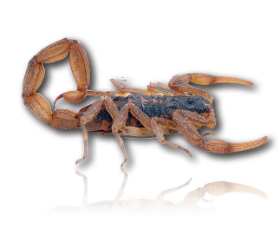

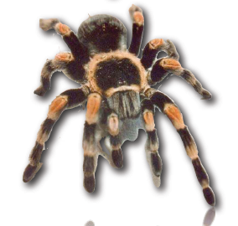

Slide 12
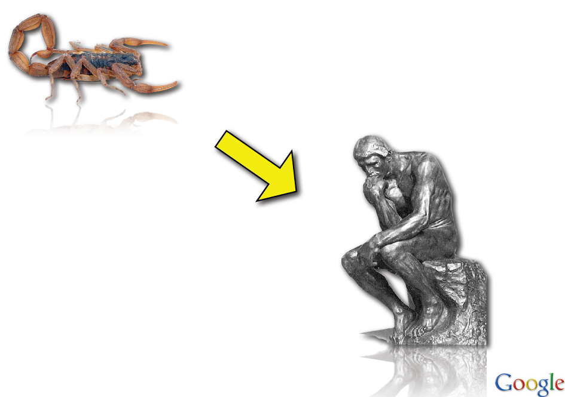
Logical Bugs
created by poor system design , poor data structure, and poor logic planning.
The cost of fixing a bug can be very high,i.e., it may require fixing many code and data structures, which require more testing efforts.

Slide 13
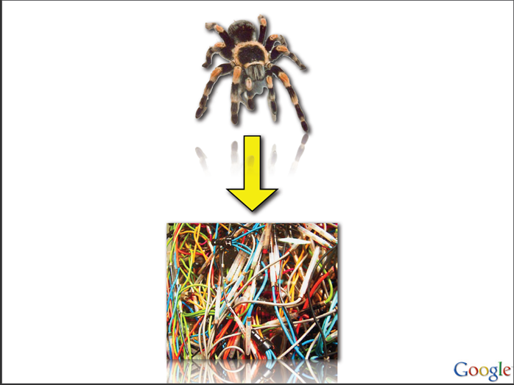
Wiring Bug
Caused by poor hardwiring programming. hardwiring programming produces too many possible execution paths.
Such code lacks of deep understanding and thinking of the problem, which often requires good data structure design and algorithms.
Fixing a bug in the problem may look straightforward, however, it is getting complicated as time goes by
引用自

Slide 14
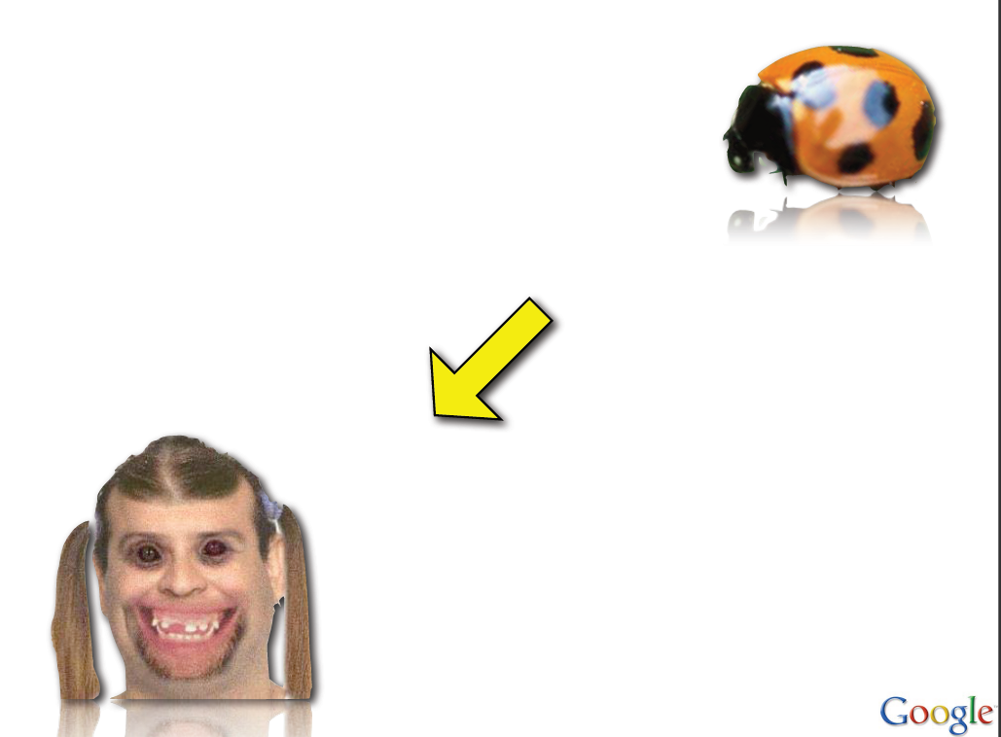
Rendering Bug
Once you find the bug, fixing it is straightforward.

Slide 15
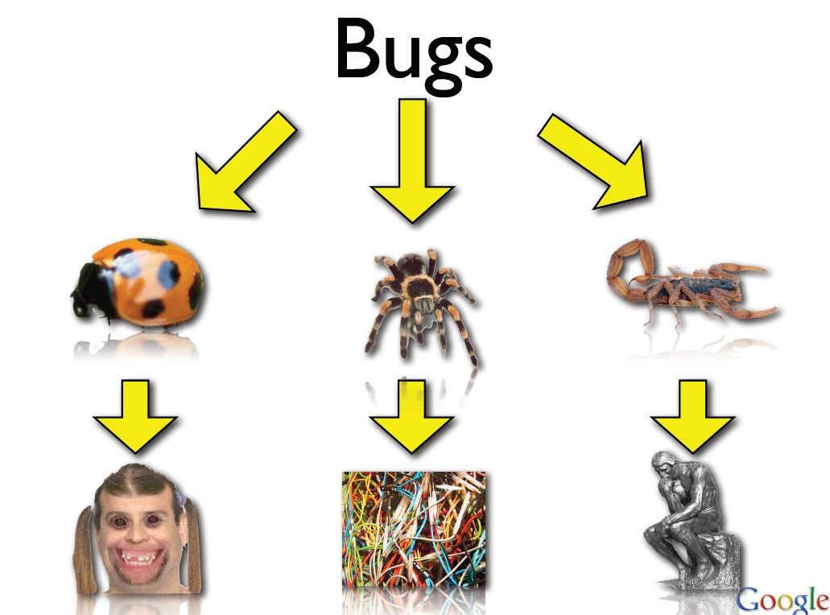

Slide 16
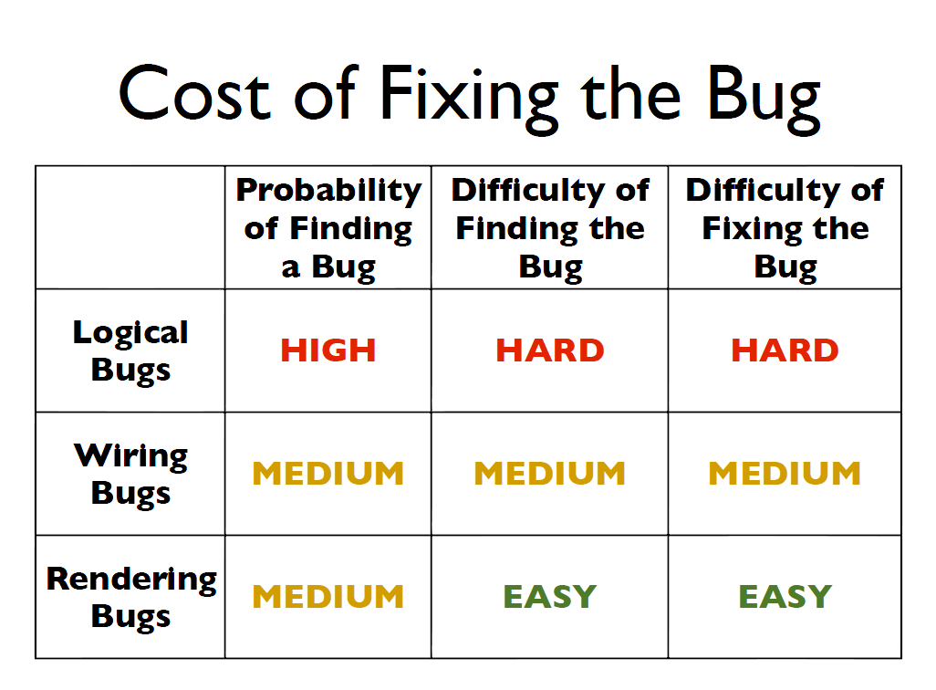

Slide 17
Comments
probability to find the bugs –
Low: You need to run many test cases to manifest a bug however, you don’t need to design hard test case specifically to manifest the bug
High: a bug is easily manifested when you execute some test cases.
difficulty to find the bugs –
Low: you don’t need to design tricky test cases to find the bugs.
High: You need to design tricky test cases in order to trigger the conditions for manifesting a bug.

Slide 18
Unusual Bug)
Due to the progress of modern software techniques, new techniques are introduced or old techniques become prevalent and widely adopt.
Multithreading
Networking
GUI and object-oriented techniques.
The thread behaviors can be obscured by encapsulation, inheritance, and polymorphism
Signal/CallBack (Interrupt-Driven Like System)
These techniques can introduce unusual bugs

Slide 19
Unusual bug
Heisengbug
borrowed from Heisenberg Uncertainty Principle
bug that is difficult to reproduce
even it is reproducible, it disappears once you observe it.
program behave differently in debug mode, optimization mode, release mode
Examples
race condition
deadlock
memory not properly cleaned and initiated.

Slide 20
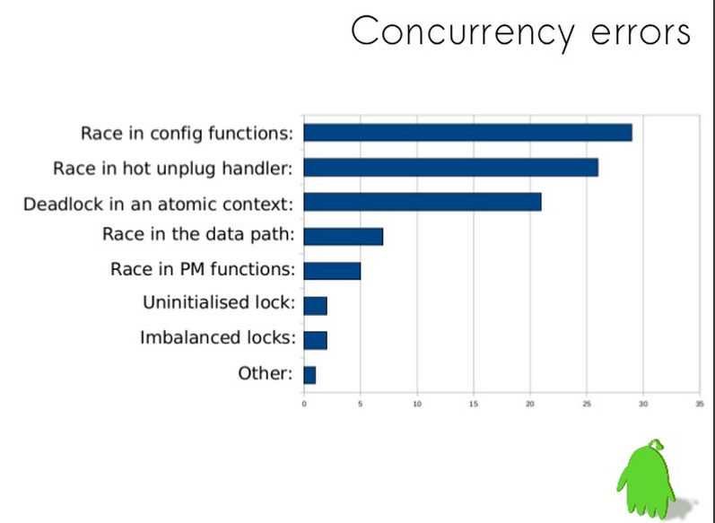

Slide 21
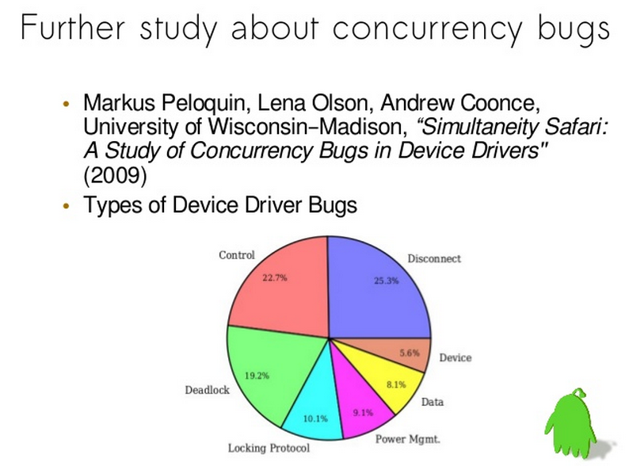

Slide 22
bug
Bohrbug
A repeatable bug; one that manifests reliably under a possibly unknown but well-defined set of conditions. Sometimes it is not easy to trigger the conditions.
Examples
an overflow bug

Slide 23

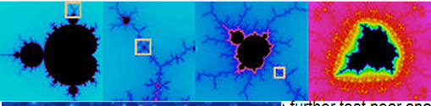
Unusual Bug
Mandelbug [ from the Mandelbrot set ]
A bug whose underlying causes are so complex and obscure as to make its behavior appear chaotic or even non-deterministic.

Slide 24
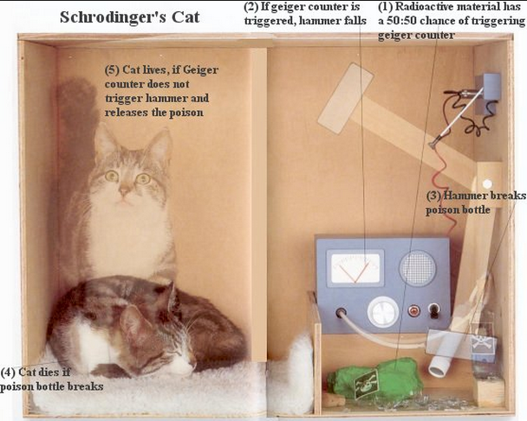
Unusual bug
Schrödinbug
when you read the code and then you know actually it is very easy to trigger such bugs. Such bugs not triggered, you are just lucky.
Often written by poor programmers which likes to write weird code and your team never do code review.
PS: This programmer should never be hired in the first place.

Slide 25
Unusual bug
Statistical bug
Introduce random number generator, probability makes your program bugs irreproducible.
You many need to accumulate large number of runs to find the bugs

Slide 26
Reproduce the Bugs
In practices, reproducing a bug may not be an easy/intuitive task, particularly
bugs are unusual bugs
reproducing the test environment is too costly
bug only happens in accumulated data, but you cannot access the data due to security or authentication issues.

Slide 27
DEBUGGER

Slide 28
An Overview of Debugging
Debug is an inevitable process of software development. According to a survey, programmer may spend 1/3 work time (or more) in debugging.
Seldom taught formally in school.
CS professors think students can learn the skill by themselves if they write more code (?)
The difficulties of debugging increases as the system complexity increase.

Slide 29
Typical Debugging Process
Reproduce bug (can be a non-trivial task in many applications)
Simplify the problem (by smaller test data)
example 1: A program may crash while reading or processing large amount of data. If you can find a simpler test data that can reproduce the bug, debugging can be much more efficient and easy. This is one of the debugging wisdom.
Isolate the culprits
example 2: there are too many steps that can crash the program. By skipping some steps and replace the steps by input/output pair as much as possible，you can exam if the skipped step create some side effects which crash the program (Divide and Conquer)
Use the debugger to trace and examine the code step by step

Slide 30
Tracing Techniques – PRINT debug
PRINT debug
A basic technique in programming 101
insert printf/cout to print variable values at critical places in code.
print to file or screen
unless you insert “pause” command, the printing is non-stop (unless you know CTRL-S)
It is still an important debugging technique. In practice, programmer may create log which is a PRINT debug

Slide 31
Tracing Techniques – PRINT debug
PRINT debug may have the following problems
If you need to modify/add print contents, you need to change the code. Changing the code requires re-compilation. It could takes time if the scale of system is large.
When there are lots of PRINTs you may need to delete/comment them one by one.
PRINT debug may be used to print formatted output (e.g., you print a tree in a tree layout in the screen). As the visualization code is complicated, bugs can be created in the debugging code.
In some applications, printing to screen may be not available
GUI applications
High performance program

Slide 32
Example
Please compare the elapse time of the two programs
for (i=0;i<1000000; i++) {
value = i * i ;
}
for (i=0; i< 1000000; i++) {
value = i * i ;
cout << i << endl ;
}
We all took operating systems courses. I/O is very slow.

Slide 33

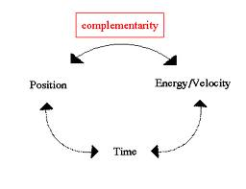
Probe effect
In order to understand the internal program states, you add PRINT commands (so does debugger)
Because you observe, in someways, you change the program behaviors. This is called probe effect
Uncertainty principle

Slide 34
Probe Effect in Practice
If your program (debuggee) contains only one thread (main()), it is called a sequential program
Adding PRINT only decrease performance and does not change the correctness of the program (School exercises are the major kind of the program). Your program simply run slower.
Bug can be reproduce repeatedly

Slide 35
Probe effect
If your program contains multi-threading, distributed/networked communications, parallel processing
Networking apps, multithreading apps, apps with GUIs… Programs in real world belonged to this category.
Probe effect (PRINT/debugger) not only slow down your program but can also alter the interleaving of threads.
Program may not reach the point you want to reproduce for debugging
bugs may not be reproduced
Be AWARE !!

Slide 36
Tracing Techniques - Debugger
Debugger (System Program)
allow you to set break points and there is no need to recompile the system
At break point you can watch variables
At break point, you can check call stack
Source level debug
You can execute program one by one and then observe the results immediately and easily.
It is much more efficient compared to PRINT debug
If you never use it before and don’t think it is necessary, it is a sign that your programs are small (ACM programs?)

Slide 37
An Introduction to Debugger
Debugger is an important system program
Any CPU manufacturer wants to attract developers, debugger is a must support system program.
System programs include compiler, linker, debugger, assembler …
debugger is a very complicated system program
A debugger of its original form is console-mode (command line)

Slide 38
Most Well-known C/C++ Debugger GDB
GDB: The GNU Project Debugger (http://www.gnu.org/s/gdb/)
It can debug the following languages
Ada, C, C++, Objective-C, Pascal, Python (and many other languages),
Unix based, but it is also ported to Windows, Mac
Console mode based

Slide 39
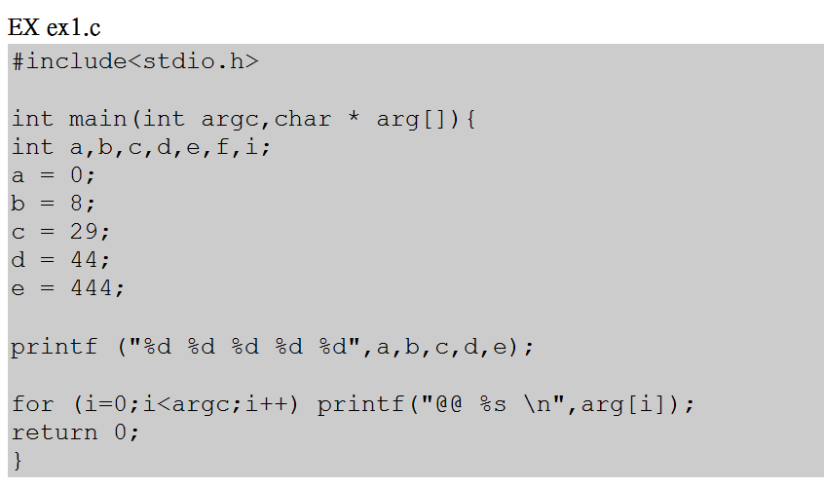
The example to debug a C program by GDB
A debuggee: ex1.c

Slide 40
Add Debugging Information
To use GDB, give the following command
gcc: GNU C compiler
“-g” tells gcc to include debugging information to object files.
“-o” tells gcc to generate executable
By default, compiler does not turn on debugging option.
If debugger is integrated in IDEs (visual studio, eclipse), debug mode is a default mode when you open a project.
is93007@bsd1:[~]$ gcc -g -o ex1 ex1.c

Slide 41
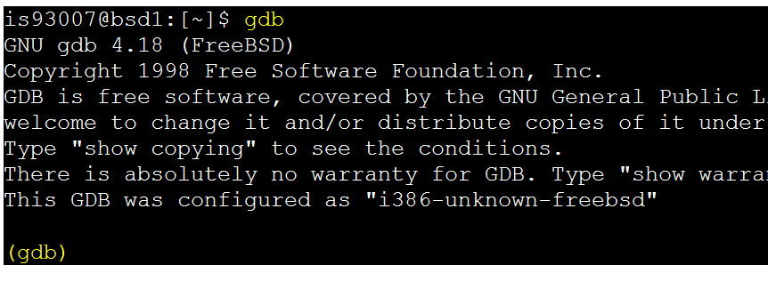
GDB startup

Slide 42
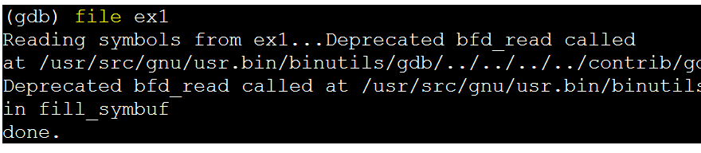
Read the debuggee
You can also run the debugger by giving debuggee as the first argument
is93007@bsd1:[~]$ gdb ex1

Slide 43
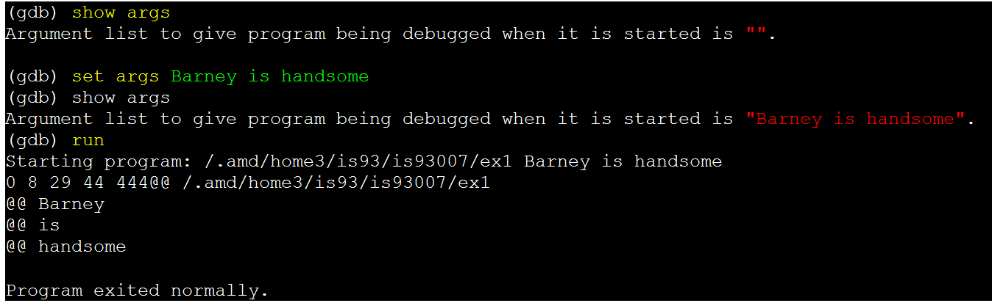
Setting arguments
main(int argc, char * argv[])

Slide 44
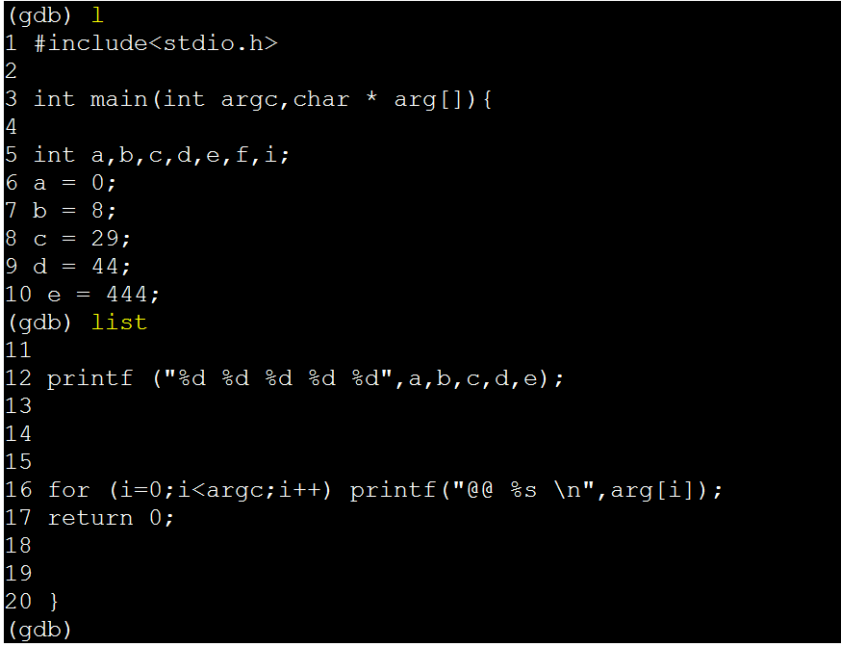
List Source Code in GDB

Slide 45
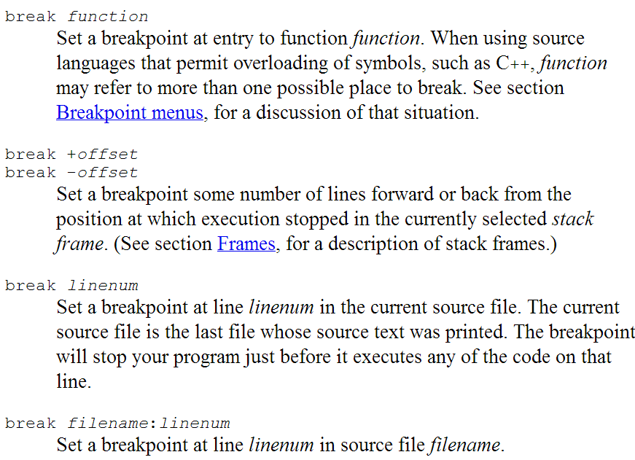
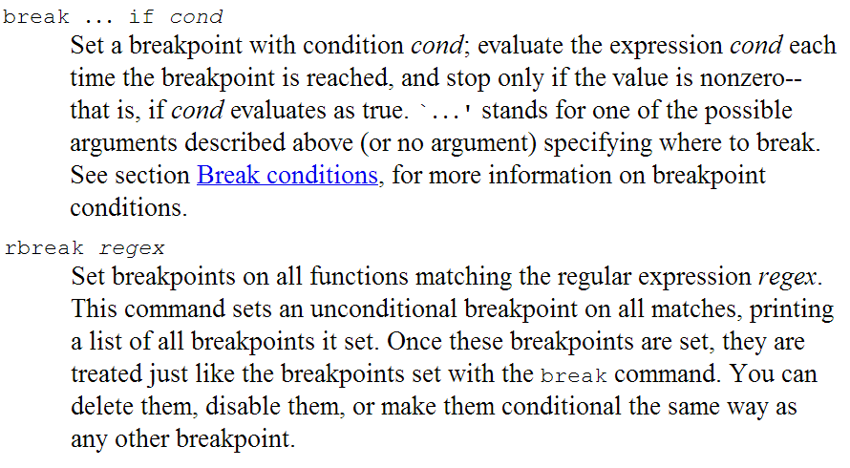
Set a Break Point

Slide 46
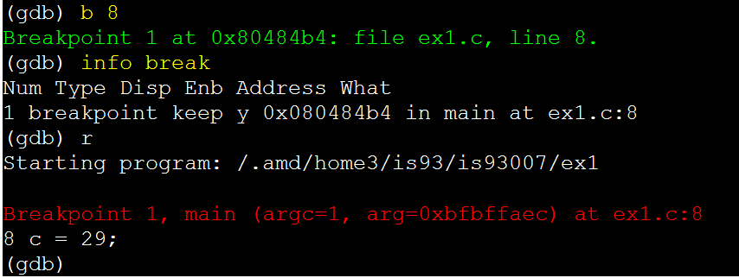
Set a Break Point and Run
(gdb) p a

Slide 47
PRINT/Watch Variables
When your program stop at a break point you can use print to print a variable
(gdb) print e
e = 444
If you want your program print the variable every time a break point is hit, use display
(gdb) display e

Slide 48
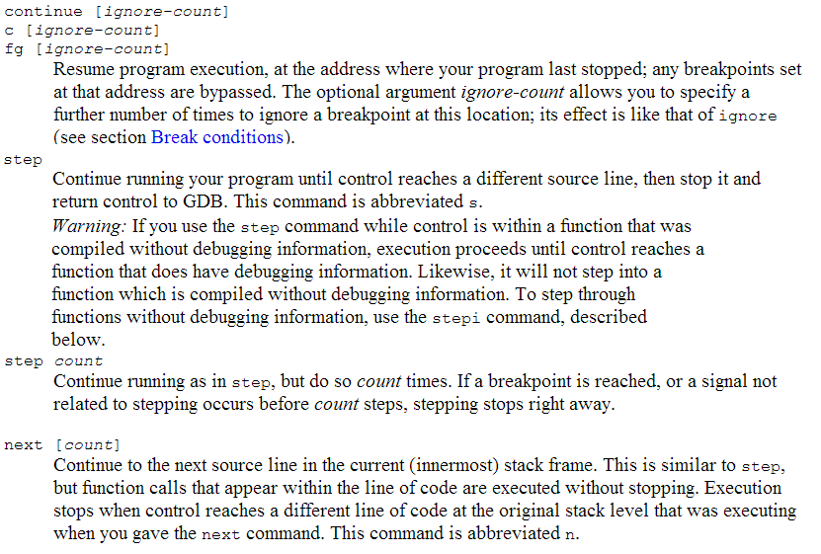
Continue your program

Slide 49
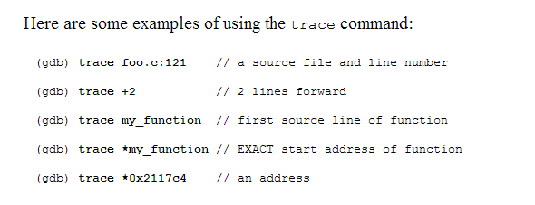
TracePOINTS
The trace command defines a tracepoint, which is a point in the target program where the debugger will briefly stop, collect some data, and then allow the program to continue. Setting a tracepoint or changing its commands doesn't take effect until the next tstart command; thus, you cannot change the tracepoint attributes once a trace experiment is running.

Slide 50
Turn on Debugging Information
Debugging information will increase10-20%的 object file
Using compiler’s optimization option may make your debugging information useless.

Slide 51
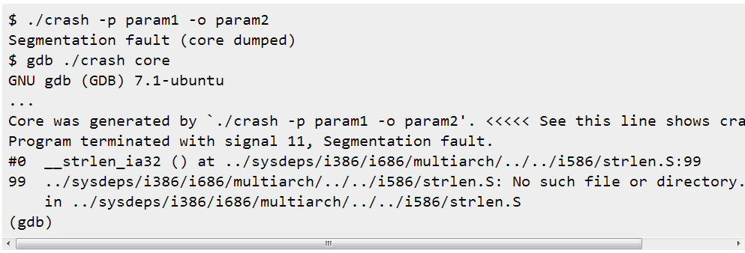
CORE DUMP Analysis

Slide 52
The Story of an Unusual bug
In our lab, we have a system called KORAT
It is intensively used daily in ADLINK (2nd largest industrial computer company)
One day, new features/many lines of code are added
Everything tested in debugging mode is fine
Unfortunately, when the program is packed into a release build and it crashes when a key is pressed
Students were stuck. The question is how to debug it?

Slide 53
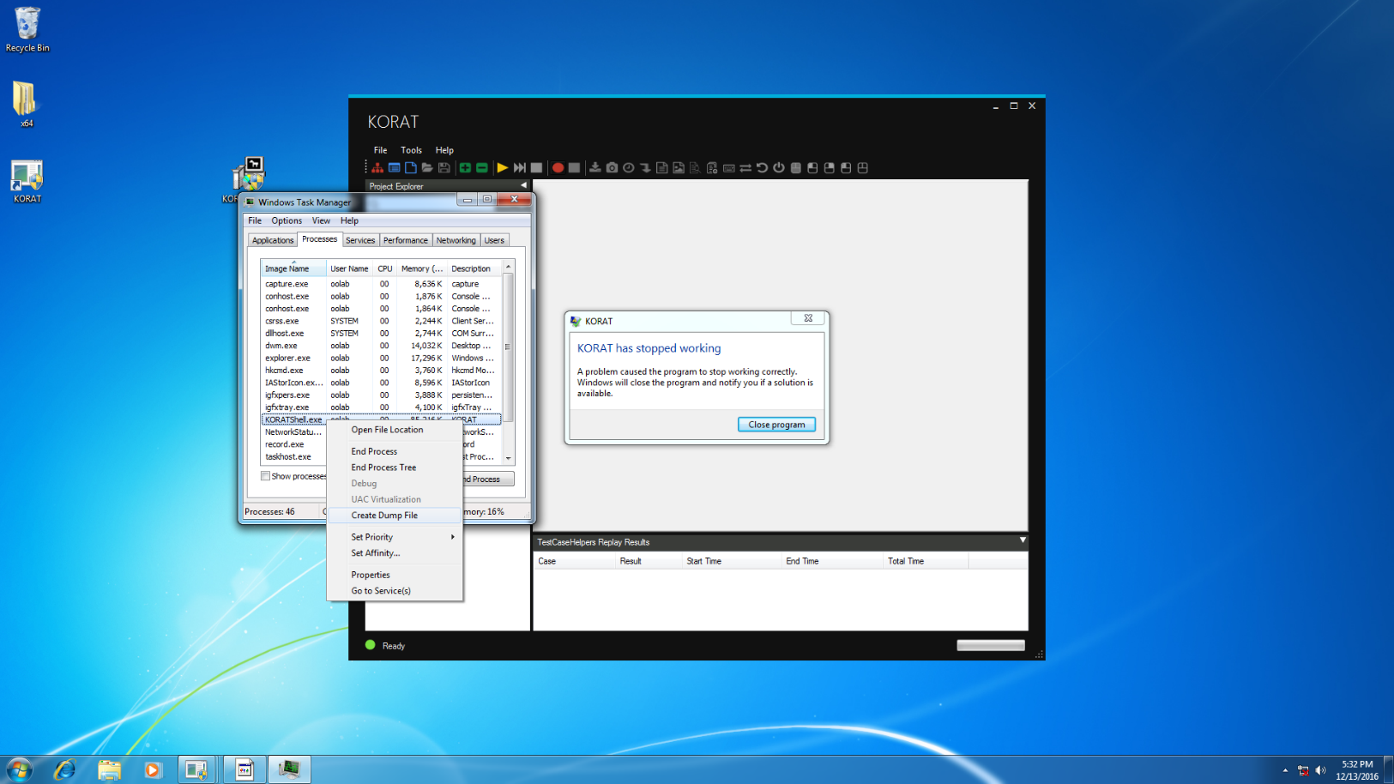
When program “KORATShell” crash …. Open task manager and Create Dump File

Slide 54
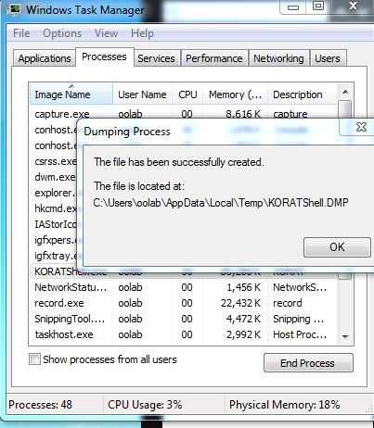
To get the dump file

Slide 55
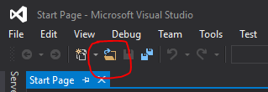
Open VS and click “open file”

Slide 56
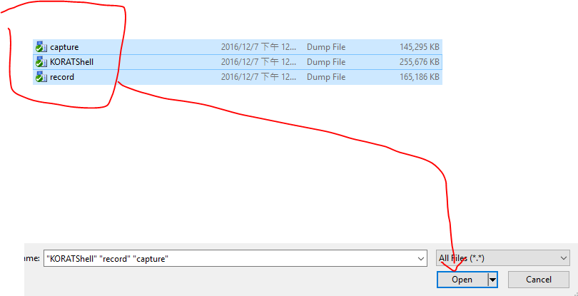
Choose the dump file and open it

Slide 57
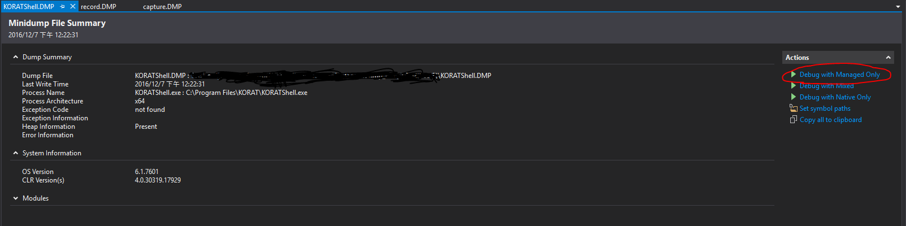
Switch tab to “KORATShell.dmp”

Slide 58
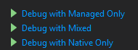
Click the “Debug with Managed Only”
p.s : please see the reference page to know difference

Slide 59
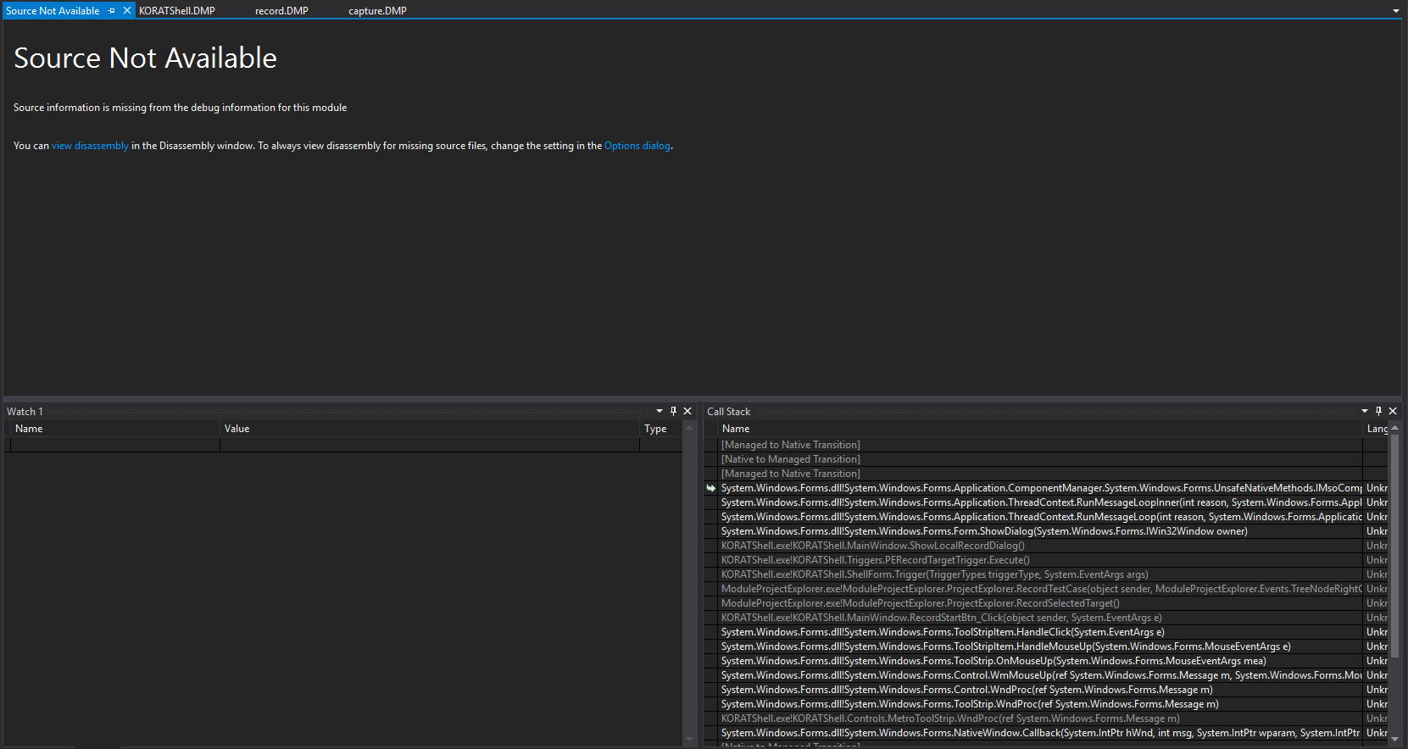
Now, we need to find our code in call Stack

Slide 60
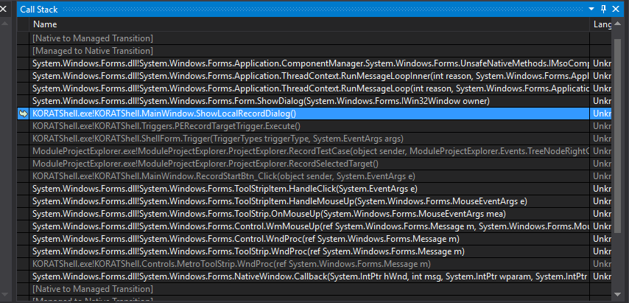
Double Click this line in Call Stack
“KORATShell.exe!KORATShell.MainWindow.ShowLocalRecordDialog() Line 45“

Slide 61
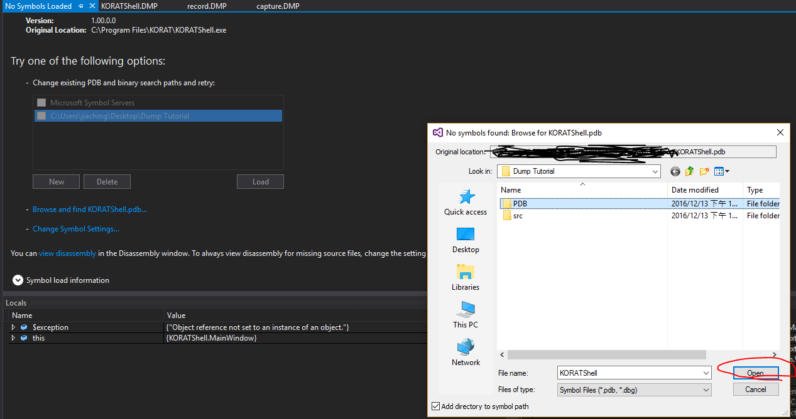
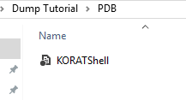
Load the “pdb” file
KORATShell.pdb in the PDB folder

Slide 62
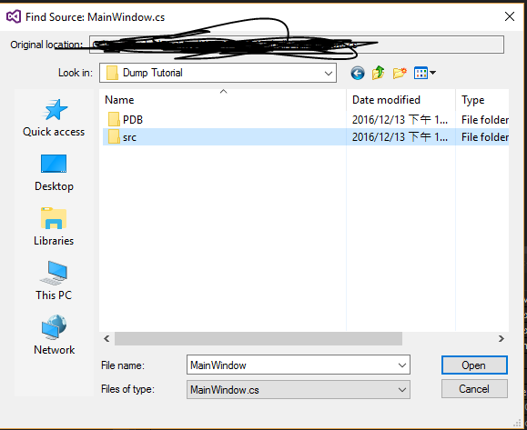
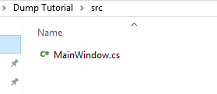
And then load the source code “MainWindows.cs”
MainWindows.cs in the src folder

Slide 63
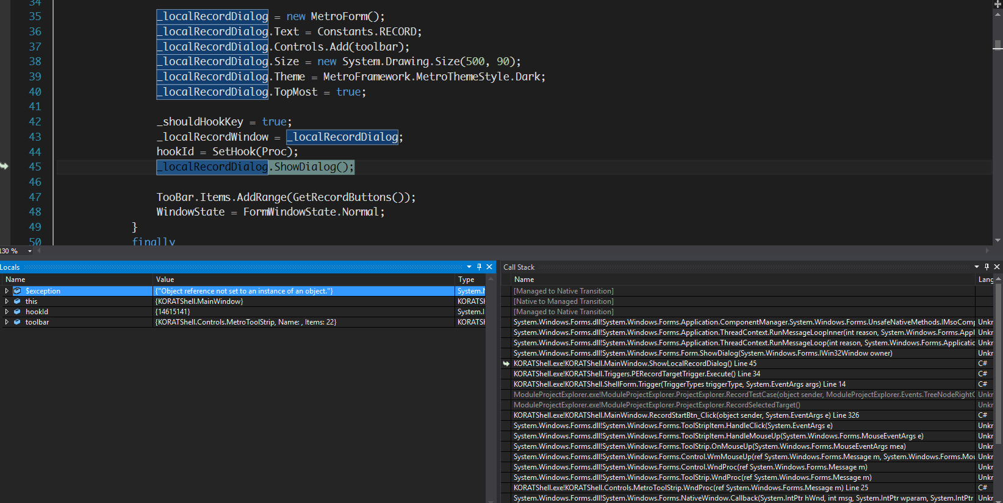
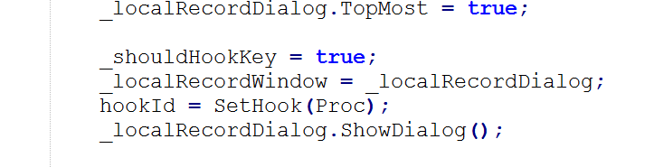
Let’s debug !!!!!!!!!!!!

Slide 64
Observations
When Window core system component throw an exception and nobody catch, your program just crash
How about C++
How about Java
The core dump analysis shows an exception is raised in user32.dll
The exception is raised due to an null reference exception
Now at least we have a clue

Slide 65
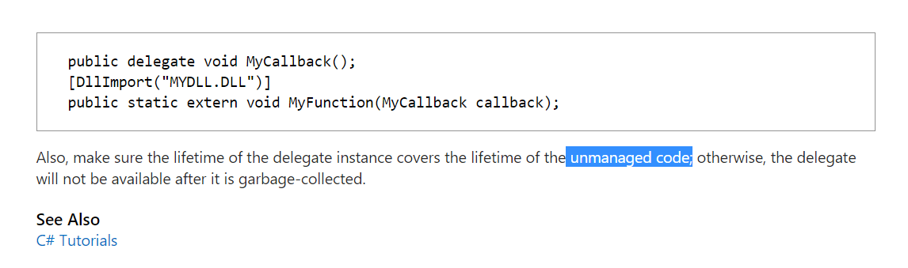
Finally, we reach MSDN

Slide 66
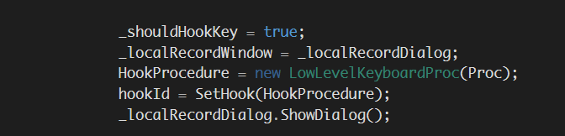
Garbage Collected? What an UNUSUAL BUG Final resolution

Slide 67
Reference
Using Dump Files
What Is Managed Code?
Difference between native and managed code?
Debug With Mixed vs Debug with Native Only when debugging dump files

Slide 68
Console-Mode Debugger Sucks?
Yes, 一般而言命令列模式的debugger 使用起來其實不夠方便(還要背指令)，對習慣視窗世代的學生而言，接受度很低。
Yes, console mode debugger is inconvenient to use
不過，做為主修電腦科學的學生，了解debugger 是怎麼樣以最原始的形式存在還是很重要的。
However, it is important for a CS major students to understand the original form of a debugger.
未來有許許多多非 win-tel 的開發平台。如果開發平台尚不支援Window GUI，則通常 debugger 的操作方式就會退回到 console mode 的使用介面

Slide 69
Debugger Wrapped by GUI
為了解決 console mode debugger 不容易使用的問題，目前整合開發環境都會將debugger 與 compiler, editor 做整合，使得除錯過程能更友善 to resolve the inconvenience of using console mode debugger, most IDEs nowadays integrate a debugger with editors in IDE.
有時候稱之為 Visual Debugger

Slide 70
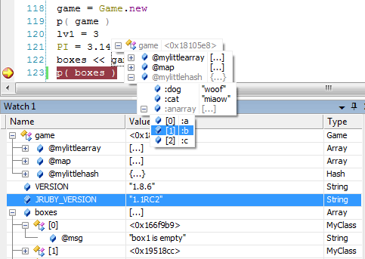
Debugging GUI – Visual Studio

Slide 71
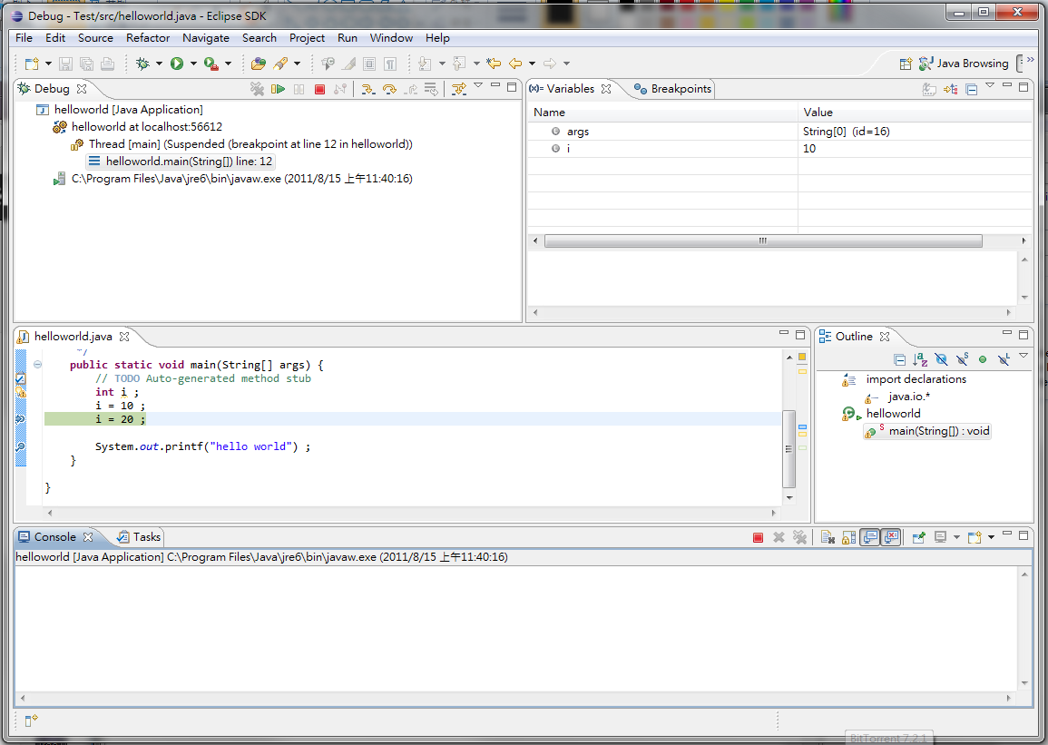
call stack
variable watch window
source code
Eclipse

Slide 72
Lab 1 – Let’s play with Java debugger under Eclipse
請開啟 Eclipse Classic 3.7
New a project called test
Enter a helloworld.java as follows

Slide 73
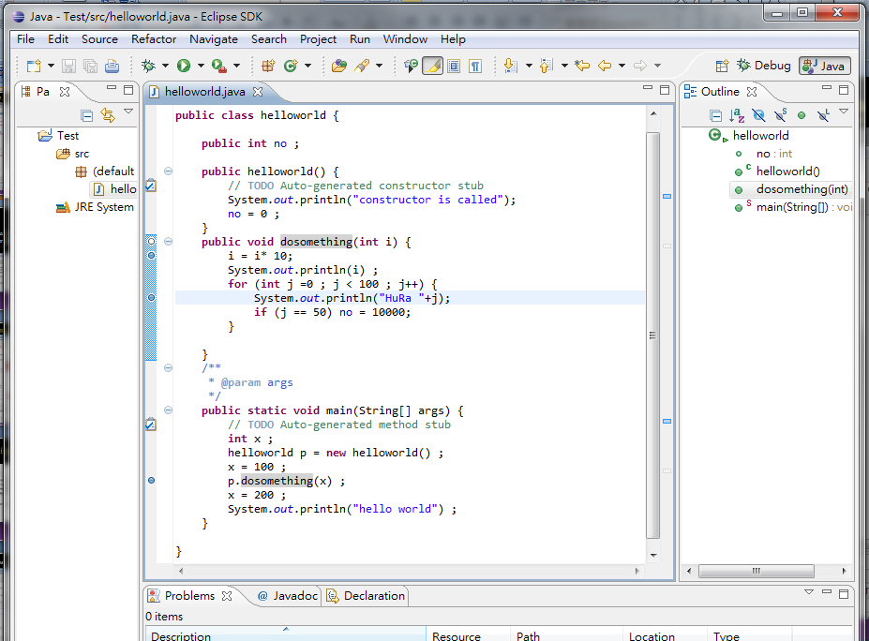
Enter a hello world example

Slide 74
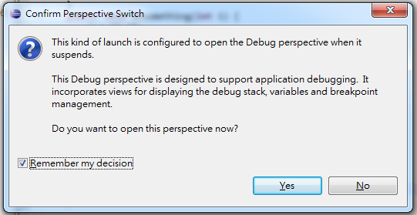
Let’s GO
Set break points
Debug the program (F11)

Slide 75
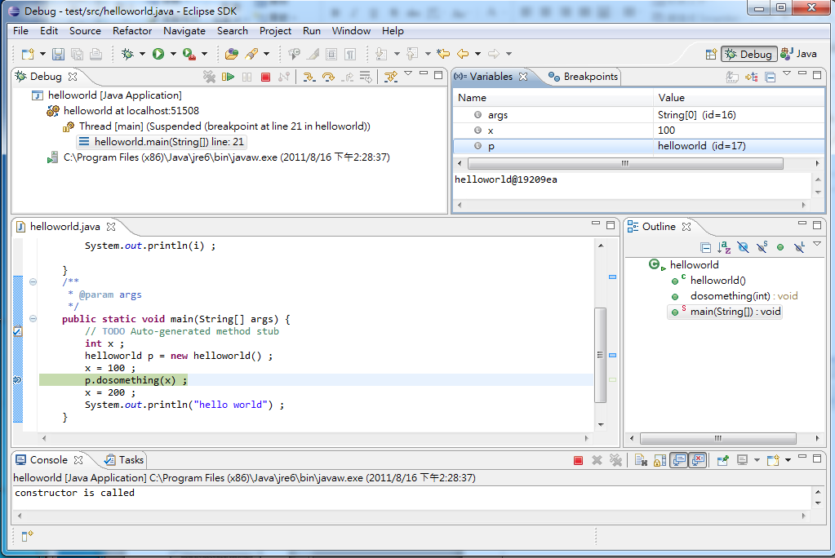
A Debug Perspective
Local
variables
call stack
your program stop here

Slide 76

Key Bindings

Slide 77

Click resume to hit the next break point

Slide 78

resume
step
next
step return
Drop to frame

Slide 79

Step Return

Slide 80

Drop to frame
Drop to frame
Full reverse debugger (too costly)
We often set a break point in the middle of a method. When the break point is hit, we may just find that some thing is wrong before this break point. Drop to the frame let you return to the start of method.
A kind of compromising reverse debugger

Slide 81

Skip All Breakpoints
Allow you to skip (disable) break points

Slide 82


Slide 83

Hit Count
Set the hit count to 50
Resume the program
Check the value of j in the for loop

Slide 84

Conditional Break Point
Enter a Boolean expression
The breakpoint will be hit when the condition is true

Slide 85

Conditional Break Point
A break point is hit when the condition evaluation changes.
So, the break point will be hit at j=0,77,78

Slide 86
Watch Point
Sometimes, computer programs can behave obscurely and weirdly. (e.g., using pointer, polymorphic, inheritance)
So sometimes you may want to stop a program when a variable is accessed/changed.
It can be particularly important if your system scale is large and it is implemented by a team, where modularity may not be clean and fully-decoupled.
You may want to know whose code mess up your data structures.

Slide 87


Place a Watch Point on a Field

Slide 88

The Options of a Watch Point

Slide 89
Attach a running process to debugger
A very common feature when you have mult-processes to debug
E.g., your program when started, fork a child process to do something else.
Just google “attach a process to a debugger”

Slide 90
Where the bugs are hidden?
OK, talk is cheap.
Even you become a master of debugging tools, unfortunately debugging requires a lot of
Experiences -- (so that you can come out with better hypothesis)
Hypothesis – evaluate the symptoms so that you can guess where could go wrong
Set break points
Poor hypothesis -> useless break points -> waste of time-> make other guesses
It can get much more complicated if your system is
Large and complicated
Built by a lot of people in different teams.
Your system is not well designed or modularized.

Slide 91
The Story of god of coding

Slide 92

Newbie, Senior, and GuRU

Slide 93
The source of errors
Class or Method
Class or Method
error propagation
Class or Method
Errors found or program crashes

Slide 94
Some Common DEBUGGING Approaches
Read the source code and find the bugs
Stupid and inefficient
Sometimes works because the bug is so trivial
Step by Step check if each step has problems
Using steps in a debugger and check variables in each break point
Doable but time consuming
Divide and Conquer
Check middle point results (set break points)
If the results are correct, the chance that the bug is hidden in the second half of the program is much higher
Keep narrow the search by setting break points
Simplify the test case so that the error can still be reproduced.

Slide 95
The Right Solution
Mastering debugging tools is a must for a good developer.
However, even you can debug quickly
The question is can you really debug every kinds of bugs in short time
If you spend a lot of time in locating the source of errors, it could mean
Your coding quality is poor
Your system modularity could be poor so that bugs can be hidden in your code.

Slide 96


Best Debugging Strategy?
Let the bug be manifested by themselves.
But HOW?
Can you see the bug?

Slide 97

Can we catch the sign of an error earlier and close to the source of errors?
The source of error
Class or Method
Class or Method
error propagation
Class or Method
Errors that are
manifested

Slide 98

Defensive Programming
OK, when you see the green light, do you drive your car fearlessly?

Slide 99

Why we need defensive programming?
In school, mostly you complete your programming work alone.
In real world, you work with others to complete a product
The stupidest phenomenon
You join all your source codes
Build
Run
Crash
Stare at each other
Accuse each other
Push one debugging leader
A great amount of time is spent until who is to blame is settled.

Slide 100



Slide 101

AS
When a ship encounters disaster, how their ship body design prepare to deal with it?

Slide 102
Tactic No. 1 - Assertion
An assertion is code that’s used during development – typically exists through alpha testing and beta testing and removed in release
It is instrumented into your code, which is called instrumentation
Assertions are especially useful in large, complicated programs and in high reliability programs

Slide 103
Assertion in C
In standard C, you can use #include <assert.h>
void foo(int x) {
assert(x > 10) ;
}
You can also define your own ASSERT
#define ASSERT(condition, message) { \
if (!(condition)) { \
LogError(“Assertion Failed:”, \
#condition, message) ; \
exit(EXIT_FAILURE);\
} \
}

Slide 104
The Body of ASSERT in C
#ifdef NDEBUG
#define assert(_Expression) ((void)0)
#else
#ifdef __cplusplus
extern "C" {
#endif
_CRTIMP void __cdecl _wassert(_In_z_ const wchar_t * _Message, _In_z_ const wchar_t *_File, _In_ unsigned _Line);
#ifdef __cplusplus
}
#endif
#define assert(_Expression) (void)( (!!(_Expression)) || (_wassert(_CRT_WIDE(#_Expression), _CRT_WIDE(__FILE__), __LINE__), 0) )
#endif /* NDEBUG */
NDEBUG is defined
in release build

Slide 105


About ASSERT
In nowadays IDEs, when your program hit an assert failed, IDEs ask you if you want to stop/retry your executions.
At this time, you can invoke debugger to debug, check variables before assertion, and use call stack to examine how the assertion is hit

Slide 106

C++ STL assertion
When you use C++ STL inappropriately, your program will hit an assertion failed.
So at this time, you can invoke the debugger to check where in your code use the STL incorrectly.

Slide 107

Call Stack Trace

Slide 108
Assertion examples
In Java
assert denominator != 0 : “denominator is unexpectedly equal to 0.”
Example
……
assert allcost !=0 : “assert failed: in foo(), allcost is unexpectedly equal to 0.” ;
averagecost = this.salary/ allcost ;

Slide 109
What to assert ? Some examples
That an input parameter's value falls within its expected range (or an output parameter's value does)
void p(int dir, int velocity) {
assert(dir >=0 && dir < 4 ) ;
assert(velocity >= 0 && velocity < 10);
………………
}
That a file or stream is open (or closed) when a routine begins executing (or when it ends executing) void p(FILE *fp, string &msg) { assert(fp != null) ; assert(msg.getLength() >= 1 && msg.getLength() <= 255);
}

Slide 110
That a file or stream is at the beginning (or end) when a routine begins executing (or when it ends executing)
That a file or stream is open for read-only, write-only, or both read and write~ I . That the value of an input-only variable is not changed by a routine
That a pointer is non-null
That an array or other container passed into a routine can contain at least XI number of data element
That a table has been initialized to contain real values
void p(Object table[], int no) { assert(no != 0) ;
for (int i=0;i< no; i++) {
assert(table[i] != null) ;
assert(table[i].getval() >= -1 && table[i].getval() <= 1) ;
}
That a container is empty (or full) when a routine begins executing (or when it finishes)
That the results from a highly optimized, complicated routine match the results from a slower but clearly written routine 1

Slide 111
ASSERT as a safety guard for the work in the middle
When you left some part of the code to be dealt later or refined later.
If (something) {
…………. // do some normal things
} else { // right now, it should not happen
// you are not sure how this can
// be reached.
assert(false); // “under construction”
}

Slide 112
Do not confuse ASSERT with Exception handling
Assertion are used to handle errors that should never occurs in the code
Error handling (Exception Handling) is handing error you expect to occur. Such as file open errors
Assertion should be disabled in official release
Error handling is a part of system code
Assertion is inserted as debugging aid.

Slide 113

Advanced Techniques to stop error propagation

Slide 114
Good Coding Habit?
The good habits and good discipline
Never assume your data file is correct.
If you assume it, sometime it causes you days in debugging but actually your program works correctly.
Data file can be corrupted for different kind of reasons which you can never know and expect

Slide 115
The source of errors
Class or Method
assert
Class or Method
assert
assert
Class or Method
assert
assert
Program crashes or
Display incorrect results

Slide 116
Summary
Assertion can help your signal an error could already occurs, which is closer to the source of error you need to look for.
Assertions are never too many,
Remember,
crashes on an assert is good during development.

Slide 117

Well, if your system crashes without being catched by asserts ?
I could be a really bad sign

Slide 118
Software Testing

Slide 119
A Joke
有天晚上我參加一個老同學的喜宴，
同桌的人有律師、會計師，
只有我一個是電腦業界的人。
為了引起話題，我說我羨慕其他行業的人，像是律師、會計師等，在學校學的那一套終生都受用，每年就算有新法條也不會改太多。
不像我們電腦界的人，每天都在K新的技術手冊，新產品新技術隨時大翻新，改朝換代的速度讓人措手不及，所以學電腦的人看起來都比較蒼老，因為太辛苦了。
我話剛說完，一位會計師馬上回我一句：「你錯了，其實我們最羨慕你們電腦界的人，因為沒有任何行業的消費者像你們電腦界的消費者一樣好欺負。」
頓時我成了眾矢之的，
這些電腦使用者的抱怨全部集中到我身上來。
其中一位仁兄還舉了個有趣的例子，
他說：
「如果傢俱業和電腦業一樣，世界會變成什麼樣子？」以下是他講的故事：
如果傢俱業跟電腦業一樣，比如說我到傢俱店買了一張桌子，搬回家往地板上一放，啪啦一聲桌子就塌了。這時候我不會生氣、不會罵人，我會先自己檢查一下出了什麼錯。

Slide 120
我會先檢討自己，
是不是我做錯了什麼，
或是我對桌子的使用不夠熟悉。
於是我會去買書來看
(書名可能是《快快樂樂學修桌子》、
《21天學會修桌子》、《修桌子技巧與實例》、
或是《修桌子的聖經》)。
要是書看得不太懂，
我會再花錢去報名上修桌子的課程。
學完之後還是修不好，
我會請其他比較懂得修桌子的朋友來幫忙。
最後沒有辦法，
終於我打電話給原先的傢俱行，
(可能還要購買《技術支援方案》)，
結果他們跟我說：
「唉呀！你買到的是搶鮮版啦！
本來就應該有問題的」。
於是我恍然大悟原來是自己的錯，
我就再去買一張「正式版」的桌子。
回家一擺還是啪啦又塌了！
修了半天還是有問題，
再請傢俱行的技術人員來做仔細檢查，
最後終於發現問題的所在──
「我家的地板和桌子不相容」，
又是我自己的錯，
於是我得趕快幫家裡的地板升級......。
等一切都忙完了，
桌子可以使用了，
我趴在桌上寫字，
心裡充滿了成就感，
我很得意地跟網友分享我修理桌子的經驗，
並暗自慶幸自己在科技的潮流上沒有落伍......。

Slide 121
The importance of testing
Seldom recognized by academic
Professors don’t care
students don’t care
but ACM survey more than 1000 software companies. Three topics are suggested to be important to CS students
Teamwork
Software Engineering
Software Testing

Slide 122
Why testing?
Let’s look at some well-known software defects
台灣高鐵售票系統：系統上線之後當機連連，系統無法應付突然湧現的購票人潮 （no stress testing)
台灣彩卷系統：類似的問題
2000-2005- 巴拿馬國家癌症中心─5個病人接受過量的迦瑪射線照射死亡。15人引發了嚴重的併發症
2003 ─軟體造成美國東北部及加拿大停電。5000萬人受影響，3人喪生
2000 美國海軍飛機墜落，4人喪生 （控制軟體問題）
1997 韓國空難，225人喪生 （雷達控制軟體問題）
1995 美國航空在哥倫比亞撞山159人喪生（導航軟體問題）

Slide 123
Statistics
2002- 美國國家標準局報告─軟體品質每年造成595億美元 （0.6％ GDP）
國內又如何？
台北縣政府校務行政系統案例
台師大林口校區學務系統案例

Slide 124
Quality Control and Quality Assurance
Software is a product.
Good quality product requires 品質控管quality control (QC) and quality assurance (QA) 品質確保

Slide 125
Manufacturing in other discipline
在製造業的世界裡面
產品品質(quality)是很重要的一個因素
當你投入非常多成本與原物料時你永遠希望你生產出來100個產品有100個都是可以賣的
QC (Quality Control) 品質控管
製造過程從設計到生產可能有數十道到幾百道程序
每一道程序都可能影響到後面的品質
如何透過製造流程的改善(process improvement)來提高良率，一直都是製造工業的重要課題

Slide 126
How to improve quality?
在製造過程中如果能夠能夠使用機器，最好的改善品質的方式就是自動化。機器不容易犯錯而且可以不斷地重複單調無聊的工作。機器會出錯的時候通常是由於製造機器的磨損，必須重新校正。
Ex. 日本的步進馬達精確度超高的秘密。
Question
當某部分的工作不能由機器來做的時候，製造過程如何做到品質控管？

Slide 127


Assembly line in manufacturing

Slide 128
生產線
每個生產線員工只做一件夠簡單到不容易出錯的工作
生產線員工不需要夠聰明
生產線將複雜的產品製造切割成許多小步驟可以在短時間以及最少的技術內可以完成
發現產品的問題並不難.

Slide 129
Again, let’s review the engineering process of other engineering fields.
Idea （概念）
Marketing analysis (Requirement Analysis) （市場分析）
Analysis and Design （分析與設計）
Manufacturing (QC) （製造）
Testing (QA)（測試）
Release product （產品出廠）

Slide 130
Software engineering
Idea （概念）
Requirement analysis and specification (100% design) （需求分析與規格）
Design and analysis （分析與設計）(100% design, QC here?)
Implementation （程式實做） (95% design?, QC here?)
Manufacturing （製造）（compilation – no cost manufacturing)
Testing（測試）

Slide 131
Question?
Is coding a design process or a manufacturing process
Is Code a design or a product?
Again, the analog breaks
More questions
If coding is not a design process, we should be able to hire many 生產線女工 to control our quality
If coding is a design process, bad news, errors are inevitable because programmers are always doing complicated design jobs, not simple and easy job.

Slide 132
Facts
Now, you should know why software has so many bugs or notorious for being flawed

Slide 133

Programmers v.s. Assembly line worker
Programming is a job which requires perfection !! Humans are not designed to complete perfect jobs
Programmers must deal with large complexity and details
Humans are not designed to complete perfect jobs (we are a product based on “Natural Selection" & "Survival of the fittest”
Software has lots of bugs, don’t be surprised.

Slide 134


The Big GAP
?
DEMO-Oriented
research
Products
research prototypes
Do not touch if you
don’t understand
major features are usable
not responsible for bugs
prove of concepts
user friendly not guaranteed
not all the generic data format are supported.
performance can be crappy
UI is not pleasant
all features are tested
bugs are not allowed
usable
user friendly
all the generic data format are supported.
performance is tuned.
UI is well designed and pleasant

Slide 135
Software Quality
Unfortunately, software must be completed by humans, and humans are error-prone and a lot of errors !!
You should learn not to trust programmers
This is why testing is so important in matured software industry !!

Slide 136
Practical Testing Practices

Slide 137
SDLC (Software Development Life Cycle)
Requirement analysis (marketing research)
Software function/performance specification (QAs should join the project here to write a test plan)
Analysis and Design 分析
Coding and unit testing (by programmers)
Integration testing (by programmers/QAs)
Alpha testing (by QAs – a set of test cases is prepared)
Most software functions and features are basically completed
All functions are tested, no functions will be added beyond this point
Serious flaws (high severity) are solved and addressed (show stopper)
Beta testing (by Beta users)
sub-serious bugs are all fixed
Test plan has been completely executed
Bug discovering rate is lower than bug fixing rate
Release
Bug discovering rate is lower than bug fixing rate for a long period of time.
The version after fixing bugs has been regressively tested (regression test)
Quality is formally proved by QA team
All documents are ready

Slide 138
Matured software company
Marketings
Developers
QAs (testing teams)

Slide 139
Job hierarchy
Director of QA
Director of
development
Test manager
Test automation
Team manager
Test facilities
manager
Developer
manager
Developer
manager
Test automation
programmers
Test database
programmers
programmers
programmers
testers

Slide 140

Why QA must be independent from development team?
Only VIRGO programmers may have the idea of perfection.
To tell programmers to play the role of a tester is just like to have a judge admits he is wrong.
if he finds so many bugs, it proves him is a poor programmer
programmer like to finish a job not to complete it to its perfection.
From the above
QA must stand on the opposite side of developers regarding quality issues.
QA got promoted when he catches more serious bugs.
QA cannot be managed under developer team

Slide 141


Marketing
balance of
terrors
QA (testers)
Developer

Slide 142
What to test in software testing?
completeness
whether the software functionality is conformed to software specs (SRS)
correctness (functional specs)
reliability (nonfunctional specs)
compatibility (nonfunctional specs)
efficiency(nonfunctional specs)
usability (nonfunctional specs)
portability (nonfunctional specs)
scalability (nonfunctional specs)
testability (nonfunctional specs)

Slide 143

Software Testing V-Model

Slide 144
Testing tasks to be done
Write Test plan (often seen in large software company with formal QA team)
write test cases, prepare test data
test case management
file bugs
regression testing
test automation (with tools)
stress testing/load testing
security testing
test as assets.

Slide 145
Test Plan?
There are many test plan template
The major contents in a test plan
what to test?
what not to test?
estimate the cost and efforts of testing
prioritize testing tasks
how test data should be prepared.
testability
testing schedule
via review, developers and testers can communicate and check
if specs are understood mutually (communication is not as intuitive as you think)
raise any testing issues while studying the system specs

Slide 146
Testing tasks to be done
Write Test plan (often seen in large software company with formal QA team)
write test cases, prepare test data
test case management
file bugs
regression testing
test automation (with tools)
stress testing/load testing
security testing
test as assets.

Slide 147



A test case example
A REAL TEST CASE Design
When build is not ready
assertions
assertions

Slide 148
A test case example
When it becomes a
regression test cases with
Stable golden cases

Slide 149
Test Case ID example
T-SSSS-CCCCC-XXX-DDDDD TITLE
SSSS: Test Suite name
CCCCC: Component or Requirement abbreviation name –
by this name, a tester can quickly grasp what this test case is designed for
it can be a component or requirement abbreviation names.
XXX: X 的值可以是
‘A’ the test case be automatically executed
‘M’ the test case must be manually executed
‘P’ this is a positive case
‘N’ this is negative case
'B' this is a boundary case
'0' test case priority (smoke test case can be 0)
'1' ..'9'
DDDD: test case ID in a test suite. ID is not necessary be an integer. If it is an integer like “0008”, an alternative 0008A means a similar test cases.
TITLE: 50 words that can be easily displayed in a test case management tools.

Slide 150
Testing tasks to be done
Write Test plan (often seen in large software company with formal QA team)
write test cases, prepare test data
test case management
file bugs
regression testing
test automation (with tools)
stress testing/load testing
security testing
test as assets.

Slide 151

Test Case Management example using redmine

Slide 152
KORAT’s Dream
Remember !! No test cases no quality !
However, programmers hate writing test cases, particularly the paper work parts.
QA team does it (if you have one)
Can a tool record my testing activities and then make them into regression test cases?
So, I don’t need to write test cases

Slide 153

how do you verify if the test cases are good?
Code Coverage

Slide 154

Code Coverage Analysis

Slide 155
Testing tasks to be done
Write Test plan (often seen in large software company with formal QA team)
write test cases, prepare test data
test case management
file bugs in bug report system
regression testing
test automation (with tools)
stress testing/load testing
security testing
test as assets.

Slide 156

File a bug in a modern wiki bug report system
Supposeyou know the owner

Slide 157

A sample bug report

Slide 158
Attach any Files that Concern the Bug
Files to attach include
input file/data
output file/data
Log files
Core dump (memory dump)
Error log files
Tracing information (generated by Tracing tools)
……
A test report should provide any information as much as possible.

Slide 159

bug life cycle

Slide 160
Severity of Software Defects
show stopper (severity 1)
unusable software (severity 1)
Microsoft ranks the bug severity from 1-30
killing people, waste a lot of money.

Slide 161
Testing tasks to be done
write Test plan (often seen in large software company with formal QA team)
write test cases, prepare test data
test case management
file bugs in bug report system
regression testing & Test Automation (with tools)
stress testing/load testing
security testing
test as assets.

Slide 162

Regression Testing

Slide 163


Regression Testing
Rerun all the test cases when the program is modified, extended, or revised.
Automation could be hard depending on applications

Slide 164


RERUN ALL TEST cases sounds easy and straight-forward?
TEST
AUTOMATION
tests are software assets
What if you have thousands of test cases?
(even you only have 100 test cases, they can drive you crazy)

Slide 165
Testing automation
In many applications or functionalities, testing can be automated at different degrees. In contrast, many functionalities and applications are not amenable to automatic testing, where humans are needed
examples that is difficult to automate testing
testing WORD.
examples that is easy to automate
testing a sorting algorithm – you can easily write a program to check if the output is listed in ascending or descending order

Slide 166
Automatic Test Case Generation and Test oracles
If test cases can be derived automatically and then these test cases can be executed automatically and then report the error – What a perfect world ! We can fire all the testers.
In practice, this is only a dream
In many applications, Effective test cases can only be derived by human
In many applications, Executions requires human to monitor and validate if program behaviors are conformed to specs.

Slide 167

Test Oracles
Oracle – In ancient Greece, an oracle was a priest or priestess who made statements about future events or about the truths
A test oracle is a program that can determine if the program behaviors or program input/output are conformed to specs.

Slide 168
Testing automation
For testing automation, test oracle must be presented to determine the conformity between specs and programs.
In some applications, test oracles are easy to derive
In most applications, test oracles are difficult to implement or in theory, impossible to derive automatically

Slide 169
Test Automation Tools
Applications with GUI
Capture/Replay Testing Tools
When UI changes, problems could occurs.
Android testing framework (based on Junit, xUnit test framework)
test cases can be created by coding (many companies adopt such an approach.
xUnit test framework
test automation is done at a unit level (class, packages)
can escape from the troubles of setting a system test cases
coding intensive (most tasks are done by programmers)

Slide 170

Typical Capture/replay testing tools

Slide 171


Innovative Tool - Sikuli (from MIT)

Slide 172

Problems with conventional capture/replay
not adapt to UI changes very well
not applicable to drag-and-drop events which are common in nowadays multi-touch applications.

Slide 173


ADVANCED- Continuous Integration tools

Slide 174

Android Testing framework – Run this Application in Virtual Device
Right click->Run As->Android Application

Slide 175


Slide 176

Browse->Desktop->TestProject
Open TestApk.java

Slide 177

public void testDisplayBlackBox()

Slide 178

Run Android Junit Test
Right Click->Run As->Android Junit Test

Slide 179
Test Automation with Continuous integration

Slide 180

Test Magic
develop
Design
Manual Tests
Exploratory Tests
Test Magic
Automated Tests
tools

Slide 181


Slide 182







Different Kind of Testing
Test engineer
Software engineer

Slide 183
The xUnit Frameworks
Original was for SmallTalk
Kent Beck and Erich Gamma
Ported to Various languages and platforms
JUnit, CppUnit, DUnit, VBUnit, RUnit, PyUnit, Sunit, HtmlUnit, …
Good list at www.xprogramming.com
Standard test architecture

Slide 184
Writing Unit Tests
1. Write a test
Test-driven development always begins with writing a test.
2. Run all tests and see the new one fail
This validates that the test harness is working correctly and that the new test does not mistakenly pass without requiring any new code.
3. Write some code
The next step is to write some code that will pass the test. The new code written at this stage will not be perfect and may, for example, pass the test in an inelegant way. That is acceptable as later steps will improve and hone it. It is important that the code written is only designed to pass the test, no further (and therefore untested) functionality must be predicted and 'allowed for' at any stage.
4. Run the automated tests and see them succeed
If all test cases now pass, the programmer can be confident that the code meets all the tested requirements. This is a good point from which to begin the final step of the cycle.
5. Refactor to remove duplication
Now the code can be cleaned up as necessary. By re-running the test cases the developer can be confident that refactoring is not damaging any existing functionality. The concept of removing duplication is an important aspect of any software design. In this case, however, it also applies to removing any duplication between the test code and the production .

Slide 185

JUnit for Eclipse

Slide 186
xUnit Test Sample Code
public class MoneyTest extends TestCase {
//…
public void testSimpleAdd() {
Money m12CHF= new Money(12, "CHF"); // (1)
Money m14CHF= new Money(14, "CHF");
Money expected= new Money(26, "CHF");
Money result= m12CHF.add(m14CHF); // (2)
Assert.assertTrue(expected.equals(result)); // (3)
}
}
(1) Creates the objects we will interact with during the test. This testing context is commonly referred to as a test's fixture. All we need for the testSimpleAdd test are some Money objects.
(2) Exercises the objects in the fixture.
(3) Verifies the result

Slide 187
Testing tasks to be done
write Test plan (often seen in large software company with formal QA team)
write test cases, prepare test data
test case management
file bugs in bug report system
regression testing & Test Automation (with tools)
stress testing/load testing
security testing
test as assets.

Slide 188
The trend of software technology
Technology Trend
web-based (browser-based) and service-based
Cloud
Connected to Public Internet
open to security threats
The number of users can be unexpected.
Software Testing Trend
Cloud as a testing service
Stress Testing/Load testing
Security Testing

Slide 189

The Era of Clouds and Webs

Slide 190

Stress Testing
Stress testing software

Slide 191



The preparation of a stress testing
Test Plan (capture a scenario)
http requests
Web Server
Thread Groups
statistical data

Slide 192

Stress Testing Report

Slide 193
Load Testing vs. Stress Testing
Load Testing – test the system with regular loads to see if it can behave regularly within specs
Stress Testing – test the system with loads beyond expected throughput to see how system reacts

Slide 194
Testing tasks to be done
write Test plan (often seen in large software company with formal QA team)
write test cases, prepare test data
test case management
file bugs in bug report system
regression testing & Test Automation (with tools)
stress testing/load testing
security testing
test as assets.

Slide 195
Test As Asset
Most people think source code is the unique asset of a software company
Actually, tests are another important asset, particularly when a company invest so many resources.
example of mobile phone testing out sourcing. (50000 test cases)
Test Cases
Test Data
Test Reports
Test Plans

Slide 196
Testing Theory
If I have time.

Slide 197
software defects detection techniques classification
optimistic
testing
using optimistic approach can only show how good your code may be. It can not show the absence of faults
pessimistic
static analyzer, code review
mostly want to show the absence of faults
may report spurious results
compiler complains about usage of noninitialized variable

Slide 198

Optimistic v.s. Pessimistic
Optimistic

Slide 199
Comments
In principle, testing cannot show the absence of faults, so it is impossible to prove a program is correct by testing
E.g., you can not prove a sorting algorithm is correct totally by testing. To prove a sorting program is correct exhaustively, you need to test N! cases. If N = 100, it intractable.
Using exhaustive testing to obtain correctness of a program is often infeasible for common problem.
Question: How Sorting algorithms in Algorithm Course are proved correct?

Slide 200
Comments
Proof is difficult. You need to show that your solution works for all cases. Even the cases are N! and N can be arbitrary
Testing only works for a comparatively small set of input domain under reasonable cost and resources.

Slide 201
Criteria of confidence
Test Coverage (from weak to strong)
statement coverage – each statement is at least executed once.
branch coverage – each branch should be exercised at least once
path coverage – each path should be at least exercised at least once

Slide 202
Binary search flow graph

Slide 203
The weakest criteria
Statement coverage 1 test case to run 1 2 3 8 9
1 test case to run 1 2 4 6 7 2
1 test case to run 1 2 4 5 7 2 8
You only need 3 test cases to have each statement at least executed once.

Slide 204
Branch coverage
each branch can produce two choices, every choice combinations should all be exercised
there are 3 branches, so at most 2 * 2 * 2 branching choices should be exercised if loop is not considered.
So at least you need to find test cases to meet this criteria
1 2 8 9
1 2 3 8 9
1 2 3 4 5 7 2 8 9
1 2 3 4 5 7 2 3 8 9
1 2 3 4 6 7 2 8 9
1 2 3 4 6 7 2 3 8 9
In the example, there are less than 8 branching choices because it is not a complete tree

Slide 205
Path Coverage
The highest coverage
Try to find test cases which can cover all the paths
equal to exhaustive testing if you want to cover them all, which is impossible
You need to find infinite test cases which have finite (if the program must stop) or infinite length (if the program may run forever)
1 2 8 9 (finite length)
1 2 3 8 9 (finite length)
1 2 3 4 5 7 2 8 9
1 2 3 4 5 7 2 3 4 5 7 2 8 9
1 2 3 4 5 7 2 3 4 6 7 2 3 8 9
1 2 (3 4 5 7 2) * 8 9 ( finite length but very long sequence)
1 2 (3 4 5 7 2 | 3 4 6 7 2) * 8 9 ( finite length with permutations)
1 2 (3 4 5 7 2) ω 8 9
………
………
where * is finite iteration in automata theory
where ω is infinite iteration in automata theory

Slide 206
Path coverage
in a program which can run for ever, full path testing is equal to exhaustive testing
it is infeasible in practice
So, we must discover more practical path coverage criteria.

Slide 207
Independent paths (a weaker criteria)
1, 2, 3, 8, 9
1, 2, 3, 4, 6, 7, 2
1, 2, 3, 4, 5, 7, 2
1, 2, 3, 4, 6, 7, 2, 8, 9
each test case should explore statements that are not explored by the previous test cases to reduce redundant test cases
A dynamic program analyser may be used to check that paths have been executed
In practice, this is often difficult too

Slide 208
Test coverage in real world
Since different coverage criteria involve different degree of cost and time
Often statement coverage is the lower bound.
Branching coverage or path coverage can be applied to important components
Test coverage testing is widely applied in software industry. Although coverage rate mean nothing to program correctness. It is only an index to show if testing has been done adequately. Most people accept that index is closely related to software quality since test cases are executed.

Slide 209
Test coverage
IMPORTANT
If you have 100% statement coverage, it does not mean your program is correct.
Sorting algorithm is an example
you can easy derive only few test cases to have 100% coverage of your program
But to prove your program is correct is totally a different scale of the program

Slide 210
How to proceed test coverage testing?
You need to have source code to know the coverage.
You need to have tool to display the coverage rate
Each test case, you need to have someone (or in very few cases, tools) to judge the correctness of program behaviors.

Slide 211

White box testing
Test cases
output
You test an equipment by observing the internal behaviors of the equipment
also known as structural testing (text book)

Slide 212
Test coverage
Test coverage must be done with white-box testing. The tester must have source code for testing
Effective test cases must be derived from source code, which require programming skills.
So, test coverage can be done by programmers or 3rd party testing company.
In USA, Europe, there are many 3rd party testing companies.
In Taiwan, never heard of it. Maybe you should start a new one.

Slide 213

Black Box Testing
Test Cases
Outputs

Slide 214
Black Box Testing
A testing process proceed without knowing the internal behaviors of the system.
Often done by QA (Testers)
QA only interact with system by
feeding test cases by user interfaces
feeding test cases by files
feeding test cases by networking traffic
feeding test cases by consoles

Slide 215
BlackBox testing and Coverage
In principle, Black Box testing can still combine with test coverage tools, if source code is available.
Test coverage tools can be used to show the index of “how good the test cases are derived by the QAs.”

Slide 216
BlackBox Testing
In practice, QAs use blackbox testing to assure Software quality after unit testing and integration testing. They take over from developers
They focus on checking
whether the program is conformed to specs.

Slide 217
BlackBox (alpha testing) Testing
QAs test program by specs.
In common cases, specs may describe
correct behaviors
incorrect behaviors that should be avoid.
QA’s job goal
to show the presence of software errors as much as possible
test the software from a user’s perspective
test all positive, negative, and boundary cases

Slide 218
Black-box testing

Slide 219
Equivalence partitioning (partition testing)
Input data and output results often fall into different classes where all members of a class are related
Each of these classes is an equivalence partition where the program behaves in an equivalent way for each class member
Test cases should be chosen from each partition

Slide 220
Equivalence partitioning

Slide 221
Equivalence partitioning with boundary cases
Partition system inputs and outputs into ‘equivalence sets’
If input is a 5-digit integer between 10,000 and 99,999, equivalence partitions are <10,000, 10,000-99, 999 and > 10, 000
Choose test cases at the boundary of these sets
00000, 09999, 10000, 99999, 10001

Slide 222
Equivalence partitions

